Slide 1
Numerical Computing Faculty: Adnan Ullah Khan College of Computing & Information Science Lecture :03

Slide 2
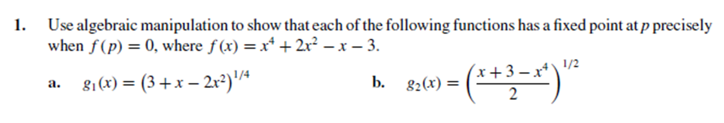
QUIZ
Find the root of above equation

Slide 3
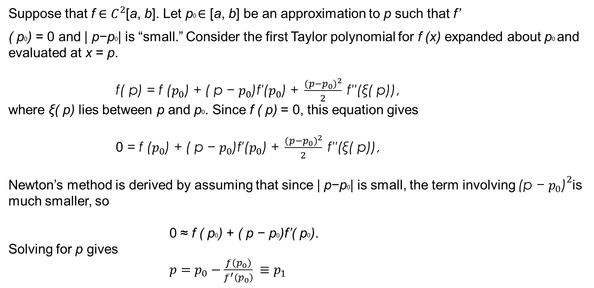
Newton’s Method
Newton’s Method: Derivation
Newton’s (or the Newton-Raphson) method is one of the most powerful and well-known numerical methods for solving a root-finding problem.
Suppose that f ∈ $C^{2}$[a, b]. Let p0 ∈ [a, b] be an approximation to p such that f’
( p0) = 0 and | p−p0| is “small.” Consider the first Taylor polynomial for f (x) expanded about p0 and evaluated at x = p.
$\text{f}\text{( }\text{p}\text{) }\text{= }\text{f}\text{ (}p_{0}\text{) }\text{+ }\text{( }\text{p} \text{− }p_{0}\text{)}\text{f}\text{′}\text{(}p_{0}\text{) }\text{+ }\frac{{(p−p_{0})}^{2}}{2} \text{f}\text{′′}\text{(}\text{ξ}\text{( }\text{p}\text{))}\text{,}$
where ξ( p) lies between p and p0. Since f ( p) = 0, this equation gives
0$\text{= }\text{f}\text{ (}p_{0}\text{) }\text{+ }\text{( }\text{p} \text{− }p_{0}\text{)}\text{f}\text{′(}p_{0}\text{) }\text{+ }\frac{{(p−p_{0})}^{2}}{2} \text{f}\text{′′}\text{(}\text{ξ}\text{( }\text{p}\text{))}\text{,}$
Newton’s method is derived by assuming that since | p−p0| is small, the term involving ${\text{(}\text{p} \text{− }p_{0}\text{)}}^{2}$is much smaller, so
0 ≈ f ( p0) + ( p − p0)f’( p0).
Solving for p gives
$p=p_{0}−\frac{f\left(p_{0}\right)}{f^{′}\left(p_{0}\right)} ≡p_{1}$

Slide 4
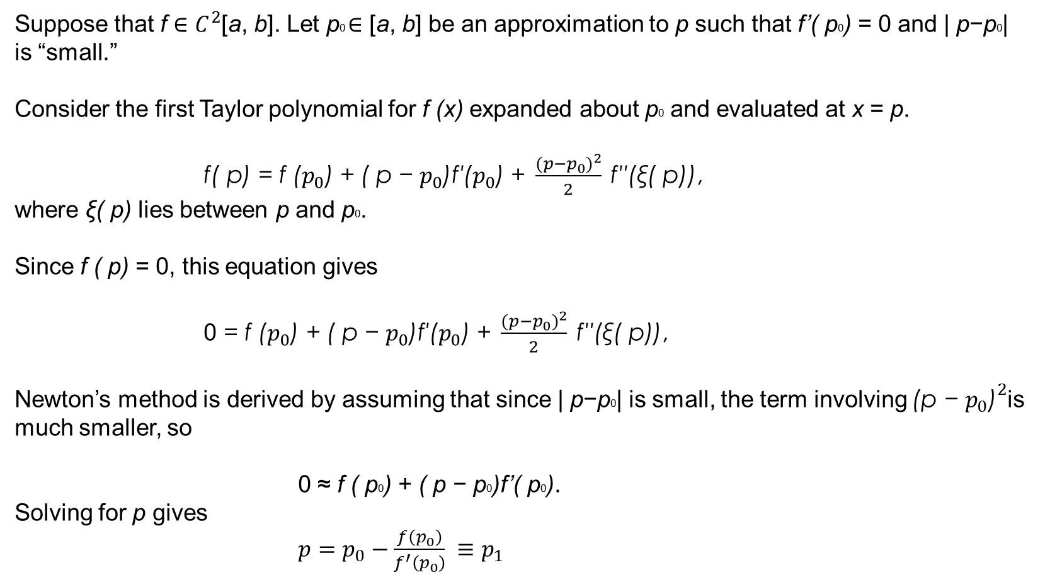
Suppose that f ∈ $C^{2}$[a, b]. Let p0 ∈ [a, b] be an approximation to p such that f’( p0) = 0 and | p−p0| is “small.”
Consider the first Taylor polynomial for f (x) expanded about p0 and evaluated at x = p.
$\text{f}\text{( }\text{p}\text{) }\text{= }\text{f}\text{ (}p_{0}\text{) }\text{+ }\text{( }\text{p} \text{− }p_{0}\text{)}\text{f}\text{′}\text{(}p_{0}\text{) }\text{+ }\frac{{(p−p_{0})}^{2}}{2} \text{f}\text{′′}\text{(}\text{ξ}\text{( }\text{p}\text{))}\text{,}$
where ξ( p) lies between p and p0.
Since f ( p) = 0, this equation gives
0$\text{= }\text{f}\text{ (}p_{0}\text{) }\text{+ }\text{( }\text{p} \text{− }p_{0}\text{)}\text{f}\text{′(}p_{0}\text{) }\text{+ }\frac{{(p−p_{0})}^{2}}{2} \text{f}\text{′′}\text{(}\text{ξ}\text{( }\text{p}\text{))}\text{,}$
Newton’s method is derived by assuming that since | p−p0| is small, the term involving ${\text{(}\text{p} \text{− }p_{0}\text{)}}^{2}$is much smaller, so
0 ≈ f ( p0) + ( p − p0)f’( p0).
Solving for p gives
$p=p_{0}−\frac{f\left(p_{0}\right)}{f^{′}\left(p_{0}\right)} ≡p_{1}$

Slide 5

Newton’s Method
This sets the stage for Newton’s method, which starts with an initial approximation p0 and generates the sequence ${[p_{n}]}_{n=0}^{∞} ,by$
$$p_{n}=p_{n−1}−\frac{f\left(p_{n−1}\right)}{f^{′}\left(p_{n−1}\right)} for n ≥1$$

Slide 6
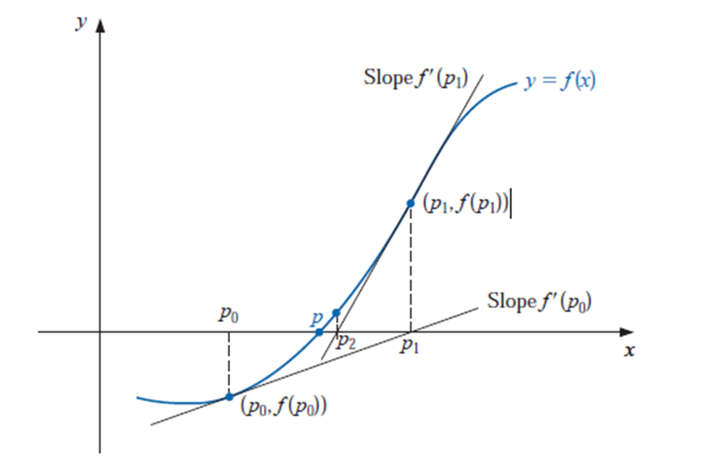
Figure illustrates how the approximations are obtained using successive tangents. Starting with the initial approximation p0, the approximation p1 is the x-intercept of the tangent line to the graph of f at ( p0, f ( p0)). The approximation p2 is the x-intercept of the tangent line to the graph of f at ( p1, f ( p1)) and so on.

Slide 7
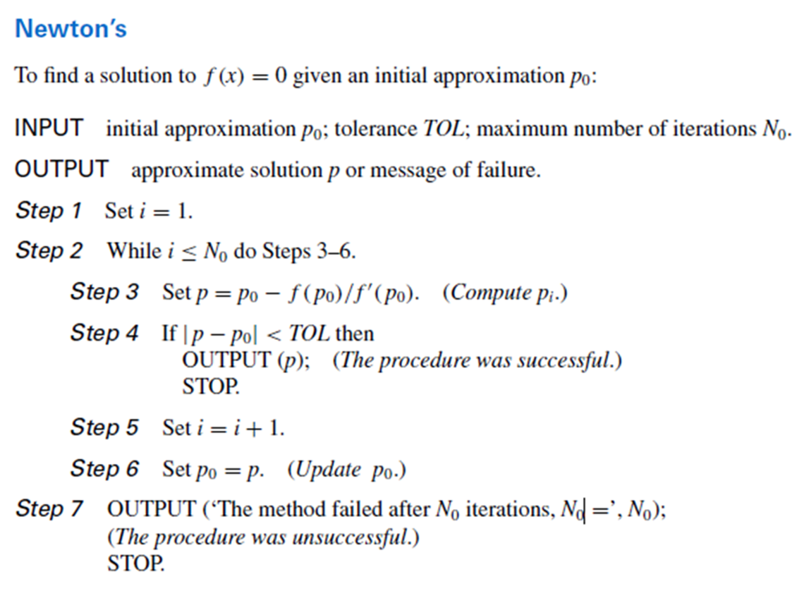

Slide 8
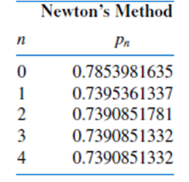
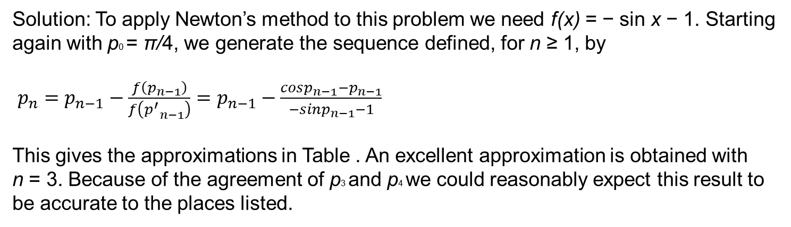
Example: Consider the function f (x) = cos x − x = 0. Approximate a root of f using Newton’s Method
Solution: To apply Newton’s method to this problem we need f(x) = − sin x − 1. Starting
again with p0 = π/4, we generate the sequence defined, for n ≥ 1, by
$p_{n}=p_{n−1}−\frac{f\left(p_{n−1}\right)}{f\left({p^{′}}_{n−1}\right)}=p_{n−1}−\frac{cosp_{n−1}−p_{n−1}}{−sinp_{n−1}−1}$
This gives the approximations in Table . An excellent approximation is obtained with
n = 3. Because of the agreement of p3 and p4 we could reasonably expect this result to be accurate to the places listed.

Slide 9
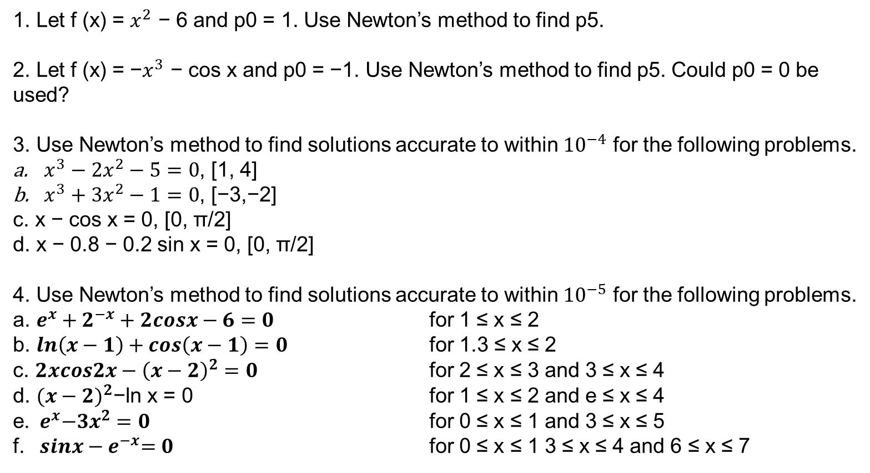
1. Let f (x) = $x^{2}$ − 6 and p0 = 1. Use Newton’s method to find p5.
2. Let f (x) = −$x^{3}$ − cos x and p0 = −1. Use Newton’s method to find p5. Could p0 = 0 be used?
3. Use Newton’s method to find solutions accurate to within ${10}^{−4}$ for the following problems.
$x^{3}−2x^{2}−5=0$, [1, 4]
$x^{3}+3x^{2}−1=0$, [−3,−2]
c. x − cos x = 0, [0, π/2]
d. x − 0.8 − 0.2 sin x = 0, [0, π/2]
4. Use Newton’s method to find solutions accurate to within ${10}^{−5}$ for the following problems.
a. $e^{x}+2^{−x}+2cosx−6=0$ for 1 ≤ x ≤ 2
b. $ln\left(x−1\right)+cos\left(x−1\right)=0$ for 1.3 ≤ x ≤ 2
c. $2xcos2x−{\left(x−2\right)}^{2}=0$ for 2 ≤ x ≤ 3 and 3 ≤ x ≤ 4
d. ${(x−2)}^{2}\text{−}\text{ln} \text{x}\text{ = 0}$ for 1 ≤ x ≤ 2 and e ≤ x ≤ 4
e.${ e}^{x}−3x^{2}=0$ for 0 ≤ x ≤ 1 and 3 ≤ x ≤ 5
f. ${ sinx−e}^{−x}=0$ for 0 ≤ x ≤ 1 3 ≤ x ≤ 4 and 6 ≤ x ≤ 7

Slide 10
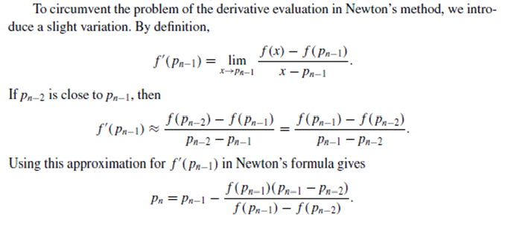
The Secant Method
Newton’s method is an extremely powerful technique, but it has a major weakness: the need to know the value of the derivative of f(x) at each approximation.
Frequently, f ’(x) is far more difficult and needs more arithmetic operations to calculate than f (x).
This technique is called the Secant method

Slide 11
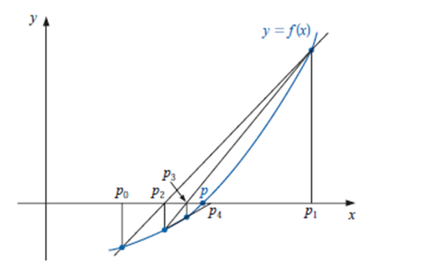
Starting with the two initial approximations p0 and p1, the approximation p2 is the x-intercept of the line joining ( p0, f ( p0)) and ( p1, f ( p1)).
The approximation p3 is the x-intercept of the line joining ( p1, f ( p1)) and ( p2, f ( p2)), and so on.
Note that only one function evaluation is needed per step for the Secant method after p2 has been determined. In contrast, each step of Newton’s method requires an evaluation of both the function and its derivative.

Slide 12
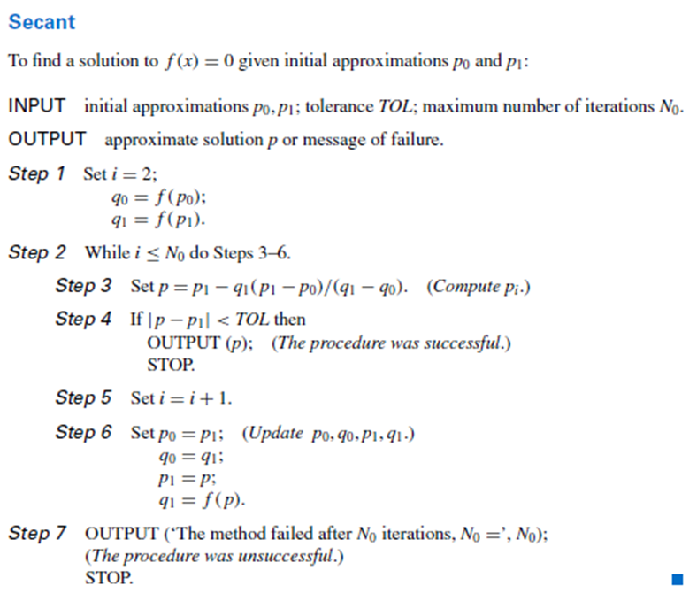

Slide 13
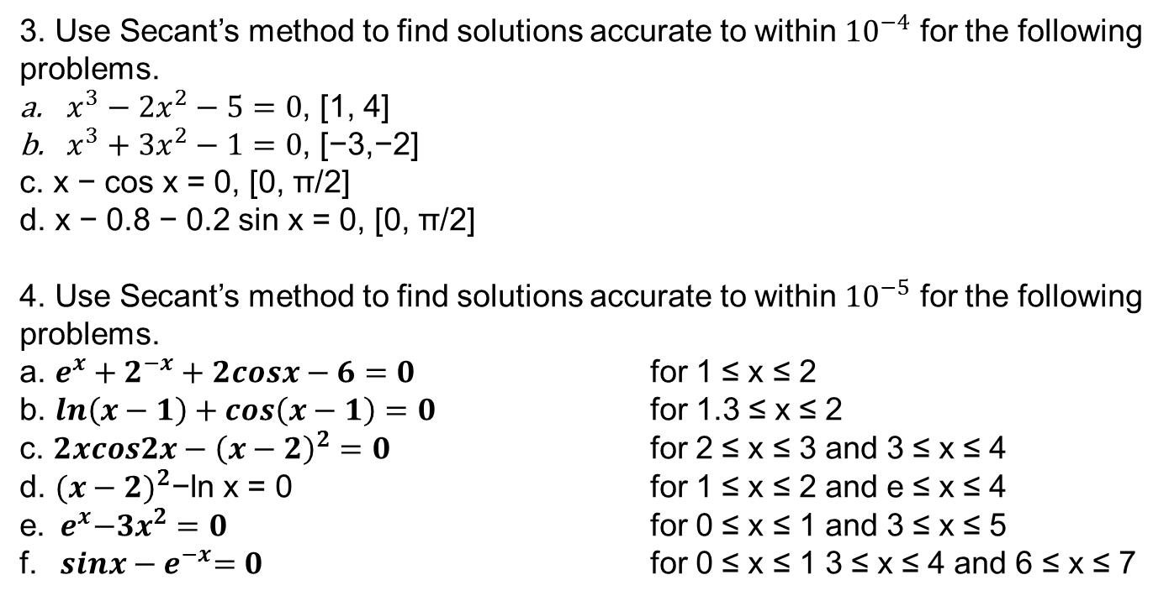
1. Let f (x) = x^2 − 6. With p0 = 3 and p1 = 2, find p3.
Use the Secant method.
2. Let f (x) = −x^3 − cos x. With p0 = −1 and p1 = 0, find p3.
a. Use the Secant method.
3. Use Secant’s method to find solutions accurate to within ${10}^{−4}$ for the following problems.
$x^{3}−2x^{2}−5=0$, [1, 4]
$x^{3}+3x^{2}−1=0$, [−3,−2]
c. x − cos x = 0, [0, π/2]
d. x − 0.8 − 0.2 sin x = 0, [0, π/2]
4. Use Secant’s method to find solutions accurate to within ${10}^{−5}$ for the following problems.
a. $e^{x}+2^{−x}+2cosx−6=0$ for 1 ≤ x ≤ 2
b. $ln\left(x−1\right)+cos\left(x−1\right)=0$ for 1.3 ≤ x ≤ 2
c. $2xcos2x−{\left(x−2\right)}^{2}=0$ for 2 ≤ x ≤ 3 and 3 ≤ x ≤ 4
d. ${(x−2)}^{2}\text{−}\text{ln} \text{x}\text{ = 0}$ for 1 ≤ x ≤ 2 and e ≤ x ≤ 4
e.${ e}^{x}−3x^{2}=0$ for 0 ≤ x ≤ 1 and 3 ≤ x ≤ 5
f. ${ sinx−e}^{−x}=0$ for 0 ≤ x ≤ 1 3 ≤ x ≤ 4 and 6 ≤ x ≤ 7

Slide 14
The Method of False Position
The method of False Position (also called Regula Falsi) generates approximations
in the same manner as the Secant method, but it includes a test to ensure that the root is always bracketed between successive iterations.
Although it is not a method we generally recommend, it illustrates how bracketing can be incorporated.
First choose initial approximations p0 and p1 with f ( p0) ・ f ( p1) < 0.
The approximation p2 is chosen in the same manner as in the Secant method, as the x-intercept of the line joining ( p0, f ( p0)) and ( p1, f ( p1)).
To decide which secant line to use to compute p3, consider f ( p2) ・ f ( p1), or more correctly sgn f ( p2) ・ sgn f ( p1).
• If sgn f ( p2) ・ sgn f ( p1) < 0, then p1 and p2 bracket a root. Choose p3 as the x-intercept
of the line joining ( p1, f ( p1)) and ( p2, f ( p2)).
• If not, choose p3 as the x-intercept of the line joining ( p0, f ( p0)) and ( p2, f ( p2)), and
then interchange the indices on p0 and p1.

Slide 15
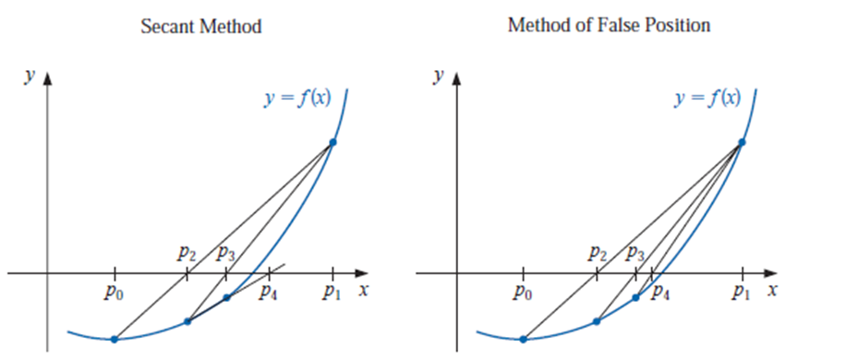
In this illustration, the first three approximations are the same for both
methods, but the fourth approximations differ.

Slide 16
